Slide 1
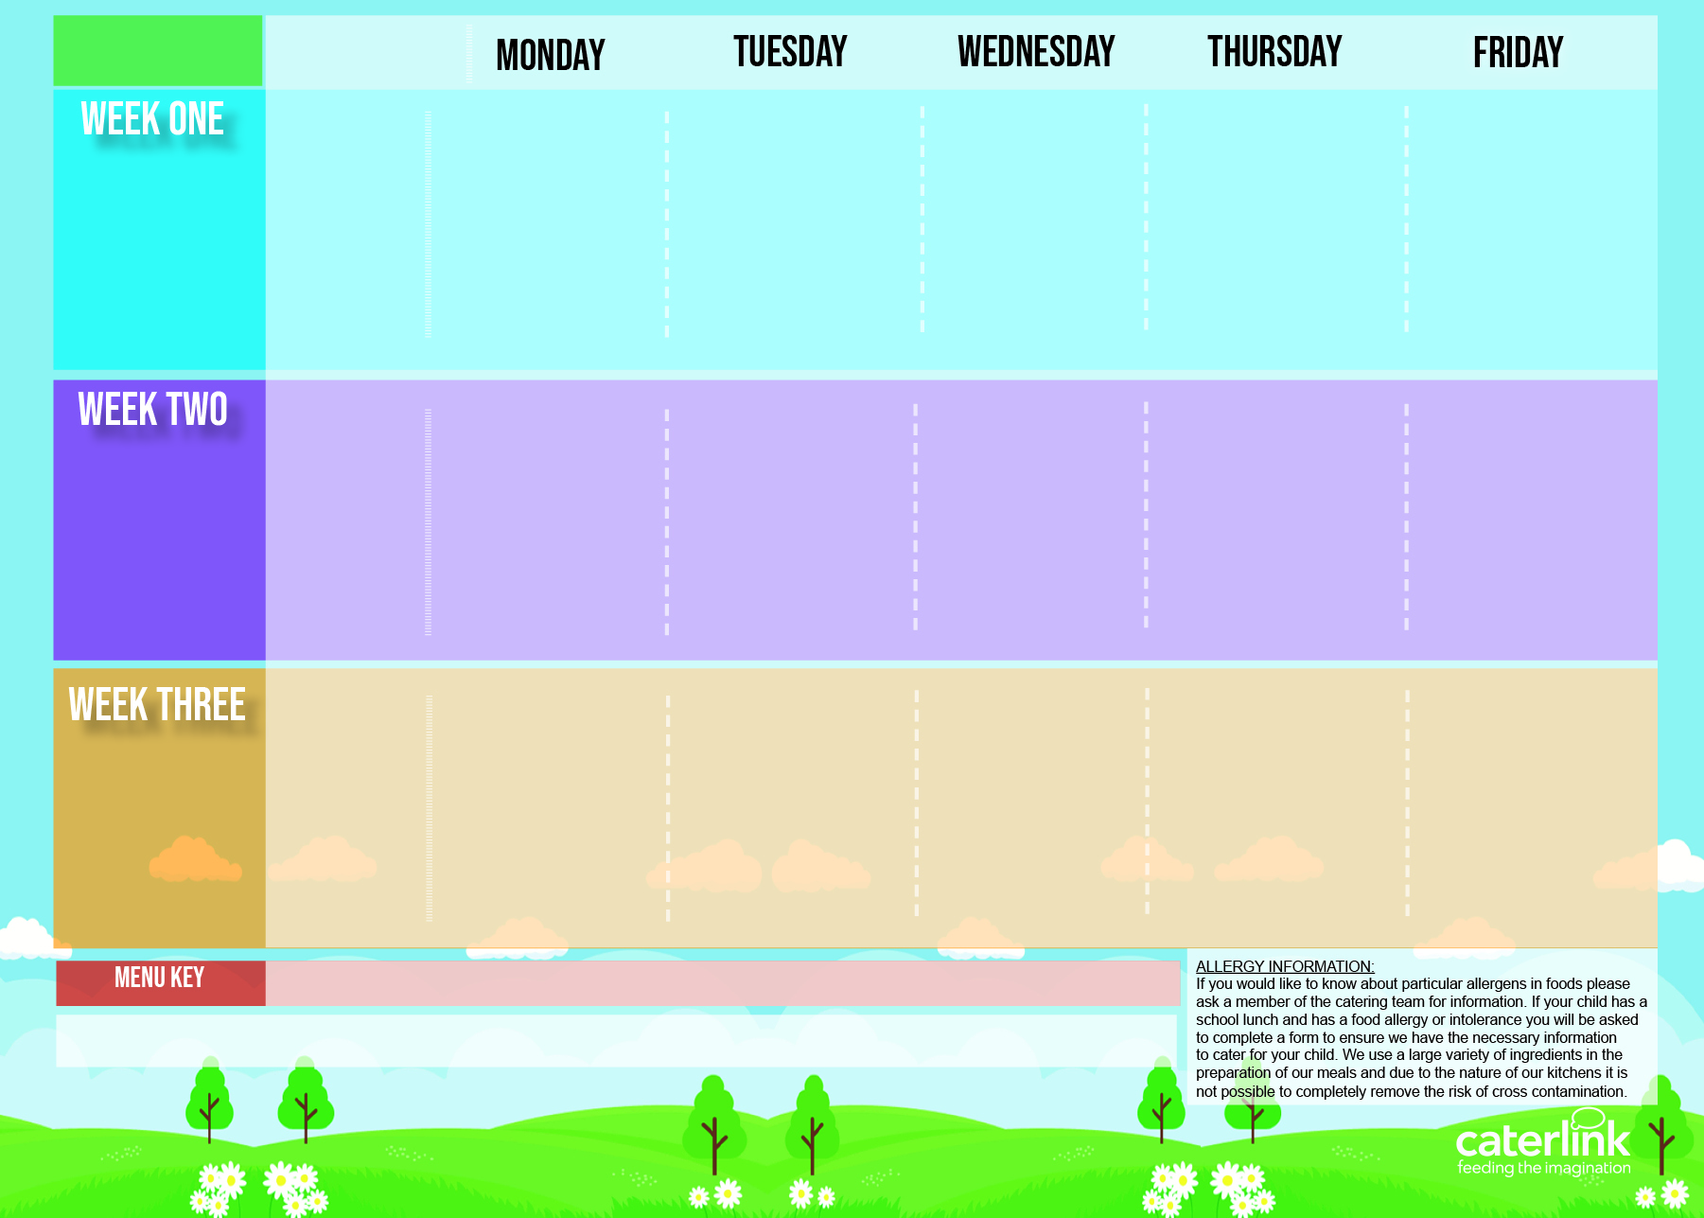
Central Autumn Winter Menu 2024 2025
Meatballs and Tomato Sauce Pasta OR Plant Balls in Tomato Sauce Pasta | Chicken Burger & Wedges OR Vegan Burger & Wedges | Minced Beef and Onion Pie with Mashed Potato OR Vegan Lasagne Jacket Potato Served with Cheese, Beans or Tuna | Roast of the Day OR Quorn Roast | Salmon Fishfingers/ Fishfingers with Chips & Tomato Sauce OR Cheese and Pepper Omelette with Chips & Tomato Sauce
Jacket Potato Served with Cheese, Beans or Tuna | Jacket Potato Served with Cheese, Beans or Tuna |  | Jacket Potato Served with Cheese, Beans or Tuna | Jacket Potato Served with Cheese, Beans or Tuna
Vegetables of the Day | Vegetables of the Day | Vegetables of the Day | Vegetables of the Day | Vegetables of the Day
Jam & Coconut Sponge with Custard | Melting Moment Biscuit | Apple Crumble and Custard | Ice cream & Mandarins | Chocolate Orange Cookie
Classic Cheese and Tomato Pizza Or Rainbow Pizza With Potato Wedges Jacket Potato Served with Cheese, Beans or Tuna | NEW BBQ Chicken With Rice OR Cheese & Broccoli Pasta | Pasta Bolognaise OR Vegetable Stack | Roast of the Day OR Vegetarian Wellington | Salmon Fishfingers/ Fishfingers with Chips & Tomato Sauce OR Cheese & Tomato Quiche with Chips
 | Jacket Potato Served with Cheese, Beans or Tuna | Jacket Potato Served with Cheese, Beans or Tuna | Jacket Potato Served with Cheese, Beans or Tuna | Jacket Potato Served with Cheese, Beans or Tuna
Vegetables of the Day | Vegetables of the Day | Vegetables of the Day | Vegetables of the Day | Vegetables of the Day
Syrup Sponge with Custard | Chocolate and Beetroot Brownie | Orange Sponge & Custard | Ice cream & Mandarins | Oaty Cookie
Sausage and Mash OR Plant Sausage and Mash served with Gravy | Beef Tortilla Stack OR Tomato Pasta Jacket Potato Served with Cheese, Beans or Tuna | Chicken Korma with Rice OR Chinese Vegetable Noodles | Roast of the Day with Stuffing, Roast Potatoes and Gravy OR Quorn Fillet Roast | Breaded Fish with Chips & Tomato Sauce OR Vegan Cheese and Tomato Pizza
Jacket Potato Served with Cheese, Beans or Tuna |  | Jacket Potato Served with Cheese, Beans or Tuna | Jacket Potato Served with Cheese, Beans or Tuna | Jacket Potato Served with Cheese, Beans or Tuna
Vegetables of the Day | Vegetables of the Day | Vegetables of the Day | Vegetables of the Day | Vegetables of the Day
Chocolate & Orange Cookie | Marble Sponge with Custard | Melting Moment Biscuit | Ice cream & Mandarins | Vanilla Shortbread
Added Plant Power
Wholemeal
Vegan
Fresh Bread – Salad Selection – Fresh Fruit – Sandwich Selection
Available Daily:

